Slide 1

SIPSIT43: MACHINE LEARNING
TOTAL NUMBER OF UNITS: 5
TOTAL NUMBER OF PRACTICALS : 10
YOUR HOST FOR THE SUBJECT : MADHAV MISHRA

Slide 2

UNIT 1
Introduction: Machine learning, --------> (Different Types of ML)
Examples of Machine Learning Problems, ------> (Real World ML Problems)
Structure of Learning, --------------------->(How the ML learns from data)
Learning versus Designing, ----------------> (Differentiate between both process)
Training versus Testing, ---------------> (Understanding both the importance)
Characteristics of Machine learning tasks, ---> (Essentials of ML Process)
Predictive and Descriptive tasks, -----> (End Business goals)
Machine learning Models: Geometric Models, Logical Models, Probabilistic Models. -----------------------------> (Glance about the models)
Features: Feature types, Feature Construction and Transformation, Feature Selection. -----------------------------> (Cumulative Process for feeding I/P data)

Slide 3



WHAT IS MACHINE LEARNING..??

Slide 4

Machine Learning is the science (and art) of programming computers so they can learn from data.
Arthur Samuel, 1959 defined Machine Learning is the field of study that gives computers the ability to learn without being explicitly programmed.

Slide 5
In other words Machine learning is concept mixtures of two components Computer Science & Statistics which further results in the creation of statistical models. These models are basically used in doing two things:
1. Prediction: make predictions about the future based on data which is from the past.
2. Inference: it invents patterns in data.
Let’s dive in deep and understand Machine Learning going ahead

Slide 6
Machine Learning is nothing but writing software programs that learn from its past experience. And if the computer program has improved its performance from the past experience then we can say that the program has learned. We can teach computer to learn from data.
Let’s try to understand this with the help of an example of a dog and cat:
We want our machine to differentiate between a cat and a dog. So we will feed some data like images, features about cat and dog one by one.
Our machine will itself try to analyse and identify some patterns to differentiate between both the animals and store these patterns as numerical values.
So whenever we ask our machine to identify cat/dog in future it should be able to find the best possible match in the data stored and tell us the results. However there might be errors. Therefore the more the data, the better prediction our machine would be able to make.
Machine learning makes our task lot simpler without coding explicitly.

Slide 7
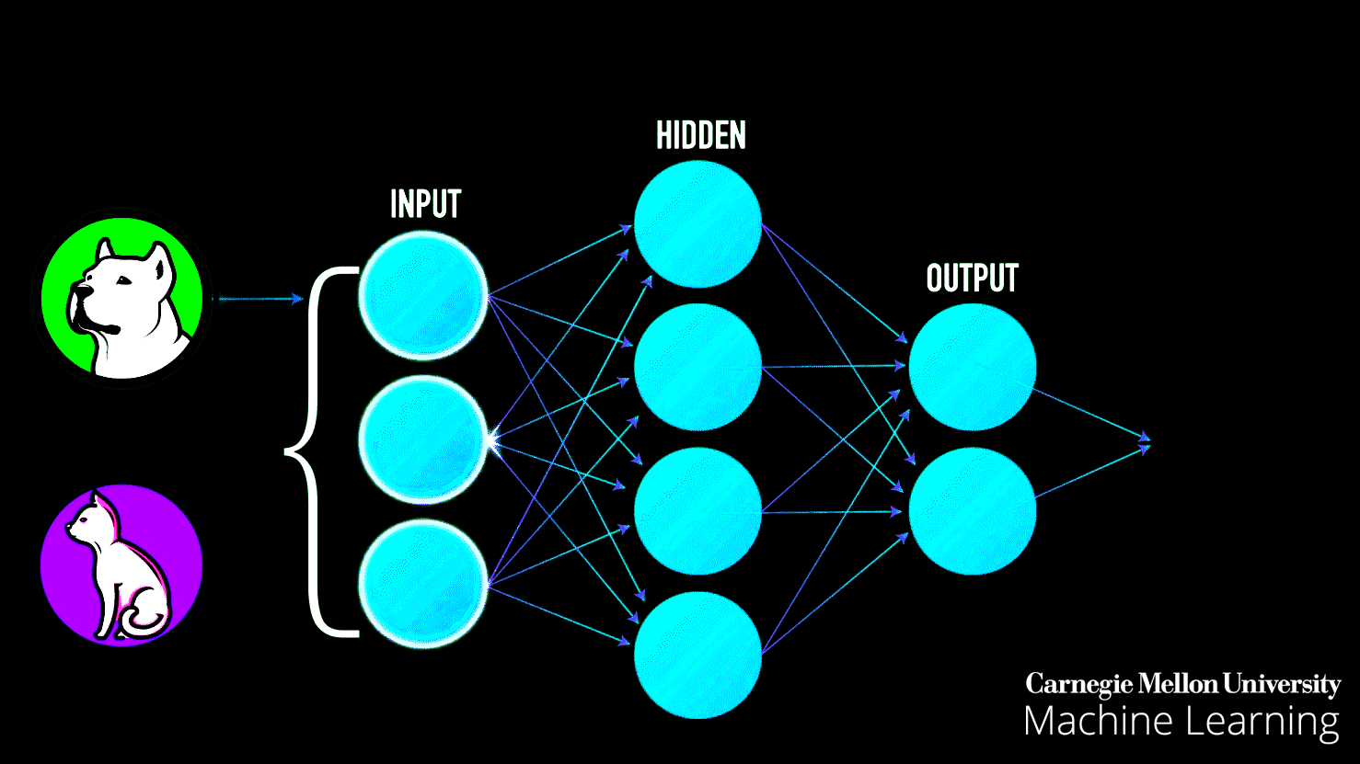

Slide 8
To elaborate more from the engineering perspective, ML can be explained: (as stated by Tom Mitchell, 1997)
A computer program is said to learn from experience (E) with respect to some task (T) and some performance measure (P), if its performance on (T), as measured by (P), improves with experience (E).
Example:
So if you want your program to predict, for example, traffic patterns at a busy intersection (task T), you can run it through a machine learning algorithm with data about past traffic patterns (experience E) and, if it has successfully “learned”, it will then do better at predicting future traffic patterns (performance measure P).

Slide 9
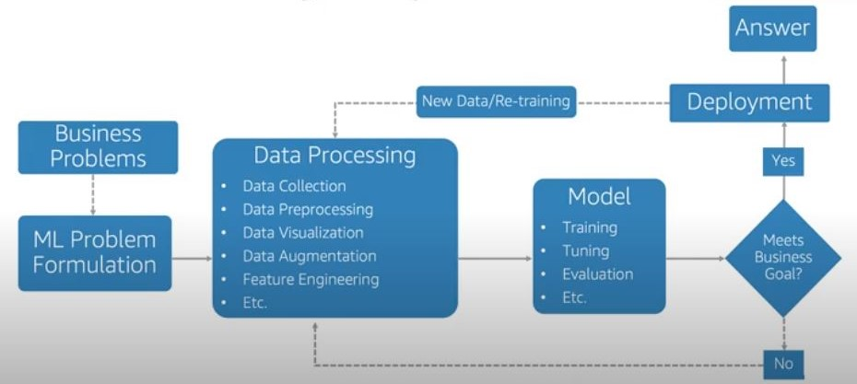

Slide 10
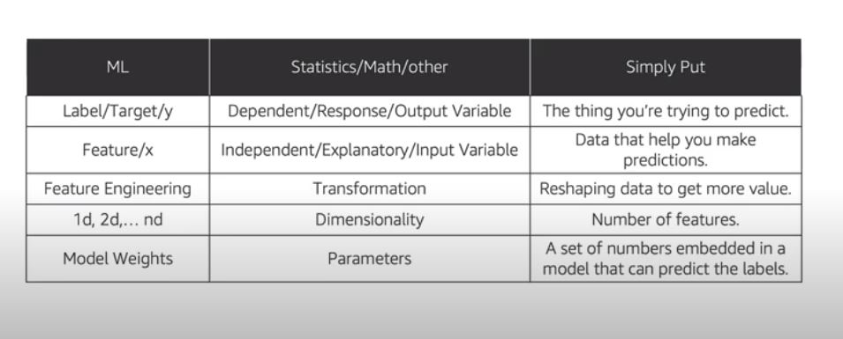

Slide 11
TYPES OF MACHINE LEARNING SYSTEMS
Supervised
Unsupervised
Semi Supervised
Reinforcement Learning

Slide 12
SUPERVISED LEARNING
In supervised learning, the training data you feed to the algorithm includes the desired solutions. i.e. (The system tries to learn with a Learner).
In this type of learning we train our machine with the labelled dataset and then our machine predicts and provide us the labels for the new set of data.
The most important Supervised Learning Algorithms:
· Linear Regression
· Logistic Regression
· Support Vector Machines (SVM)
· Decision Trees and Random Forests
· k-Nearest Neighbours
· Neural networks

Slide 13
UNSUPERVISED LEARNING
In unsupervised learning, as you might guess, the training data is unlabelled i.e. (The system tries to learn without a Learner).
In unsupervised learning algorithm, we provide the unlabelled dataset to our machine and it tries to analyze and find patterns within the dataset.
Example: Segment online shoppers into clusters that exhibit similar
The most important Unsupervised learning algorithms are:
Clustering
· k-Means
· Hierarchical Cluster Analysis (HCA)

Slide 14
Semi Supervised Learning
Algorithms that can deal with partially labelled training data (Supervised) & a lot of unlabelled data (Unsupervised). I.e. Combination of Supervised learning and Unsupervised learning. This is called semi supervised learning.
Reinforcement Learning
Reinforcement Learning is a type of Machine Learning, and thereby also a branch of Artificial Intelligence. It allows machines and software agents which can observe the environment, select and perform actions, and get rewards in return (or penalties in the form of negative rewards).

Slide 15
EXAMPLES OF MACHINE LEARNING PROBLEMS
Spam filtering: identify email messages as spam or non-spam.
Medical diagnosis: diagnose a patient as a sufferer or non-sufferer of some disease.
Customer segmentation: predict, for instance, which customers will respond to a particular promotion.
Face detection: find faces in images (or indicate if a face is present).
Topic spotting(classification): categorizing news articles, as to whether they are about politics, sports, entertainment, etc.
Weather prediction: predict, for instance, whether or not it will rain tomorrow.

Slide 16
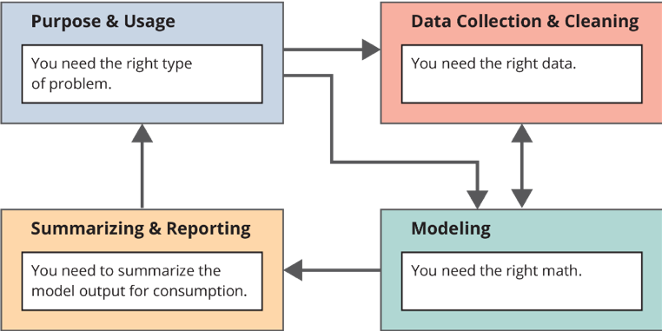
STRUCTURE OF LEARNING

Slide 17
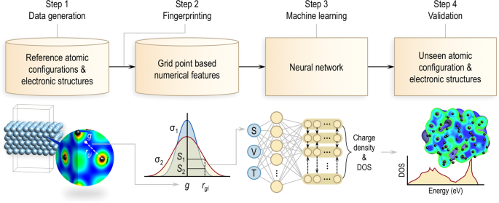
EXAMPLE FOR STRUCTURE OF LEARNING

Slide 18
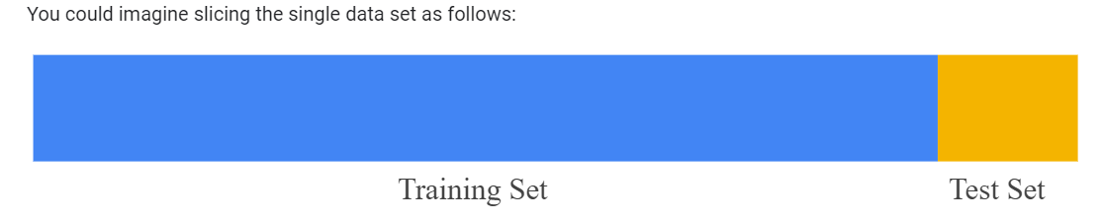
TRAINING VERSUS TESTING
Training data and Test data are two important concepts in machine learning.
Training Data—a subset to train a model.
Testing Data—a subset to test the trained model.
Make sure that your test set meets the following two conditions:
Data should be large enough to yield statistically meaningful results.
Representative of the data set as a whole. In other words, don't pick a test set with different characteristics than the training set.

Slide 19
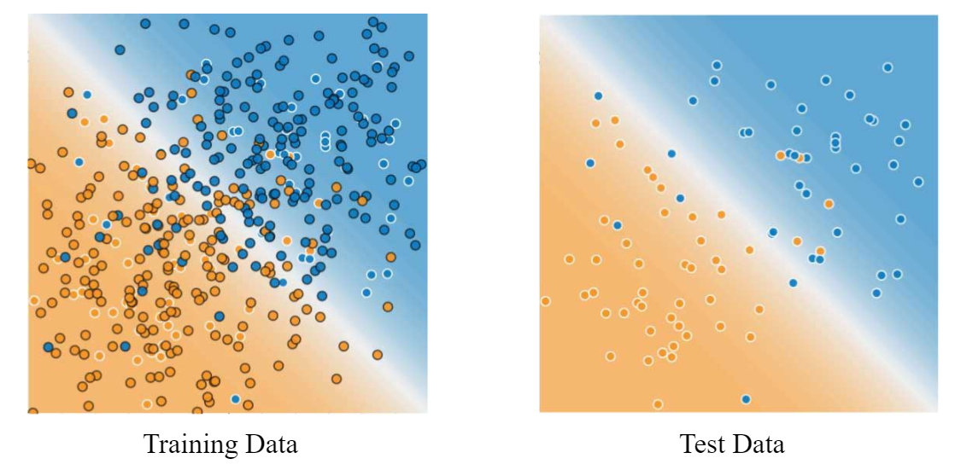
Training Data:
The observations in the training set form the experience that the algorithm uses to learn.
Testing Data
The test set is a set of observations used to evaluate the performance of the model using some performance metric.
Important :It is important that no observations from the training set are included in the test set

Slide 20
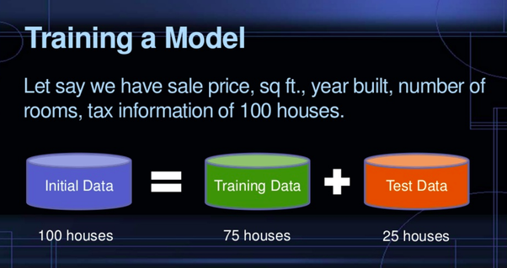
EXAMPLE OF TRAIN VS TEST DATA

Slide 21

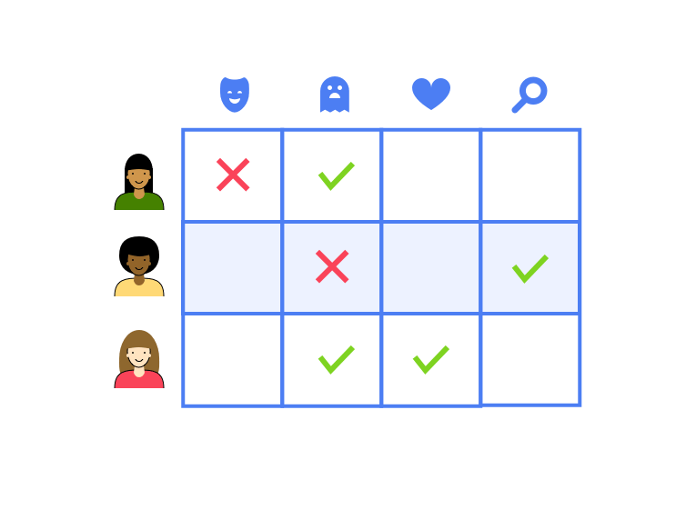
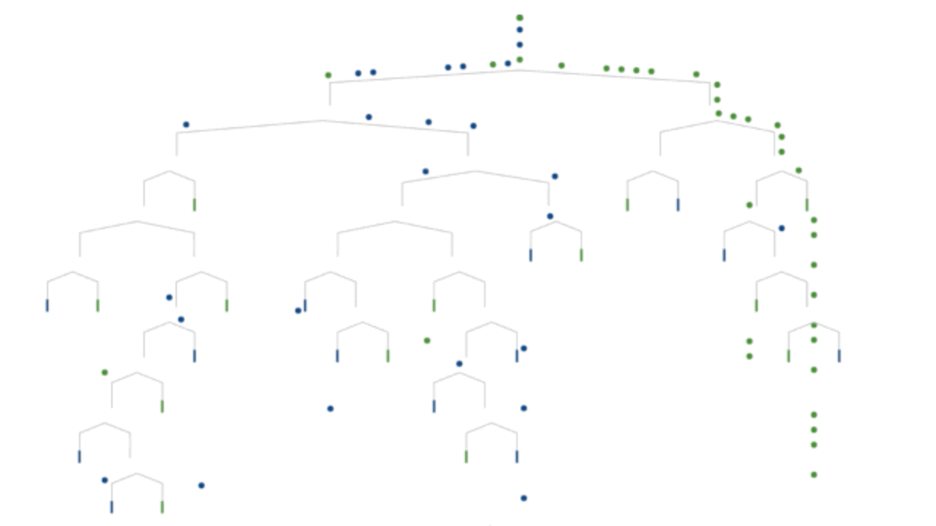
MACHINE LEARNING MODELS
What is a Model?
Model is something that is been learned for the data in order to solve a task.
Models are classified into:
Geometric model
Probabilistic model
Logical model

Slide 22
LOGICAL MODELS – TREE MODELS & RULE MODELS
Logical models uses a logical expression to divide the instance spaces into segments and hence construct grouping models.
A logical expression is an expression that returns a Boolean value ie, True or False.
Once the data is grouped using a logical expression, the data is divided into homogenous groups.
We have two kinds of logical models:
Tree Models & Rule Models
Rule models consist of a collection of implications or IF-THEN rules,
For tree-based models, the ‘if-part’ deﬁnes a segment and the ‘then-part’ deﬁnes the behaviour of the model for this segment.

Slide 23
LOGICAL MODELS – TREE MODELS & RULE MODELS
Both Tree & Rule use the same approach of supervised machine learning.
The approach can be summarised in two strategies:
1. We could first find the body of the rule (the concept) that covers a sufficiently homogeneous set of examples and then find a label to represent the body.
2. Alternately, we could approach it from the other direction, i.e., first select a class we want to learn and then find rules that cover examples of the class.

Slide 24
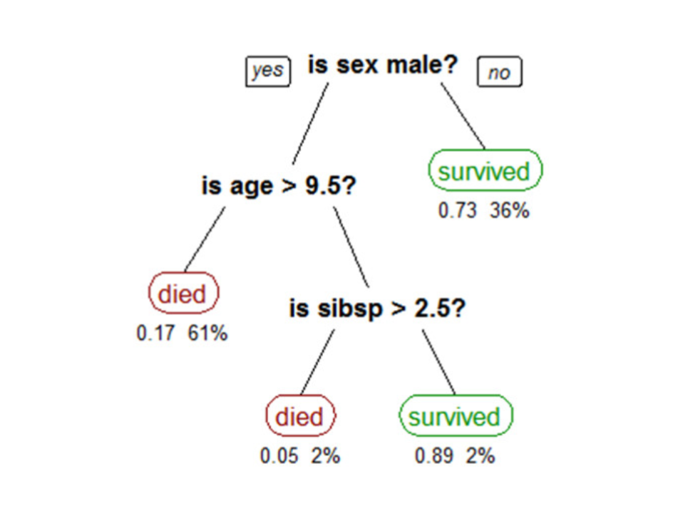
LOGICAL MODELS EXAMPLE
A simple tree-based model is shown below. The tree shows survival numbers of passengers on the Titanic ("sibsp" is the number of spouses or siblings aboard). The values under the leaves show the probability of survival and the percentage of observations in the leaf. The model can be summarised as: Your chances of survival were good if you were (i) a female or (ii) a male younger than 9.5 years with less than 2.5 siblings.

Slide 25
GEOMETRIC MODELS
Geometric models are constructed in an instance spaces by directly using lines, planes and distance.
Easy to visualize (in 2 or more instances /dimensions (2d, 3d)).
Geometric models use linear decision boundary between 2 classes ,then that class is linearly separable using decision boundary.
Example: Spam or Ham
This is called linear classifier because it is linearly divide into 2 classes.
general equation is
W. X = T
Where, W is a vector perpendicular to decision boundary
X is arbitrary point on decision boundary
T is decision threshold

Slide 26
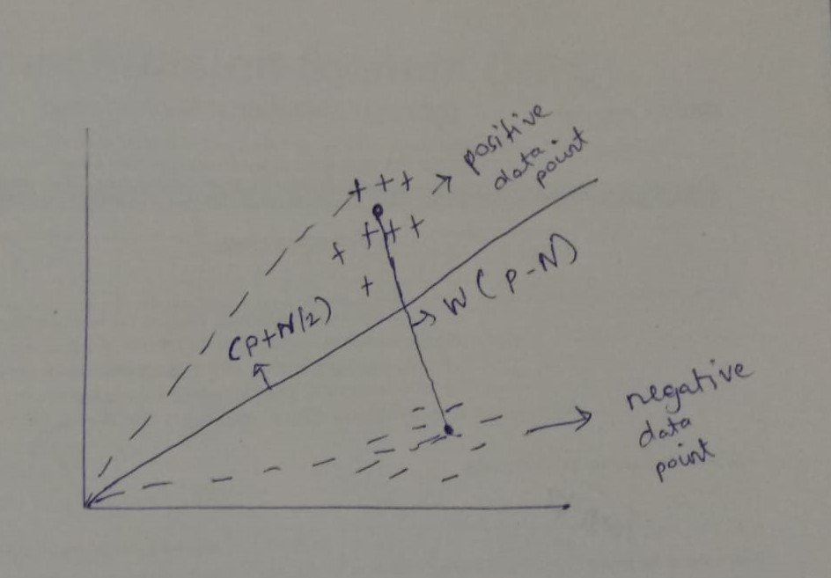
GEOMETRIC MODELS
How to find the value of W ?
w is a vector pointing from centre of mass of negative (-ve) to the centre of mass to positive +ve (centre of mass is basically average [p-n]) ,and arbitary point is [p+n/2]
w.x = t
(p-n)(p+n/2)= t

Slide 27
GEOMETRIC MODELS
Geometric concepts like lines or planes to segment (classify) the instance space. These are called Linear models.
Alternatively, we can use the geometric notion of distance to represent similarity.
If two points are close together, they have similar values for features and thus can be classed as similar. We call such models as Distance-based models.
Linear Models
&
Distance – Based Models

Slide 28
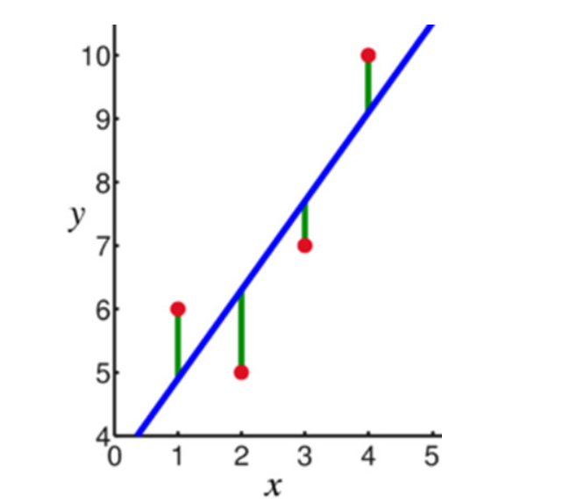
GEOMETRIC MODELS – LINEAR
Linear models are relatively simple.
In this case, the function is represented as a linear combination of its inputs.
If x₁ and x₂ are two scalars or vectors of the same dimension and a and b are arbitrary scalars, then ax₁ + bx₂ represents a linear combination of x₁ and x₂.
In the simplest case where f(x) represents a straight line, we have an equation of the form f (x) = mx + c.
where c represents the intercept and m represents the slope.

Slide 29

What is Intercept in linear model ?
the expected mean value of Y when all X=0
What is Slope in linear model ?
the slope indicates the steepness of a line
The Slope and the Intercept define the linear relationship between two variables
Linear models are parametric, which means that they have a ﬁxed form with a small number of numeric parameters that need to be learned from data.
Linear models are stable, i.e., small variations in the training data have only a limited impact on the learned model.

Slide 30
GEOMETRIC MODELS – DISTANCE BASED
Distance-based models work on the concept of distance.
In the context of Machine learning, the concept of distance is not based on merely the physical distance between two points.
Instead, we could think of the distance between two points considering the mode of transport between two points.
Travelling between two cities by plane covers less distance physically than by train because a plane is unrestricted. Similarly, in chess, the concept of distance depends on the piece used – for example, a Bishop can move diagonally. Thus, depending on the entity and the mode of travel, the concept of distance can be experienced differently.

Slide 31
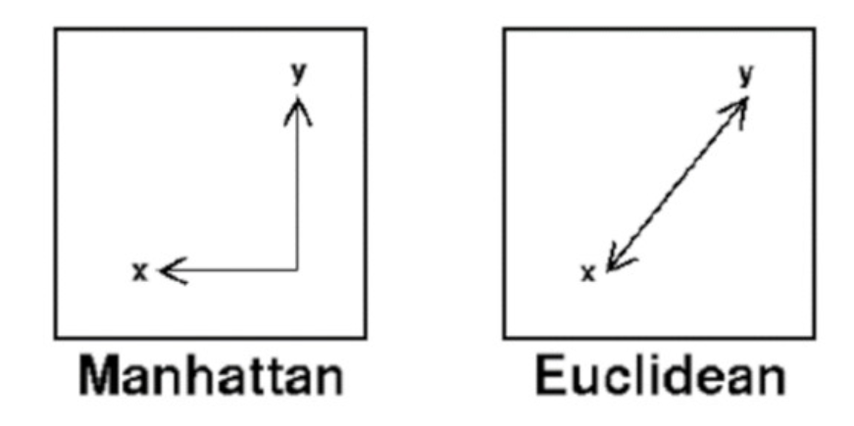
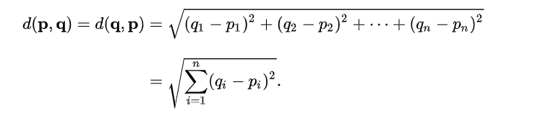
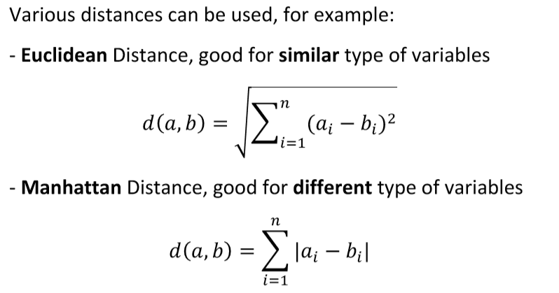
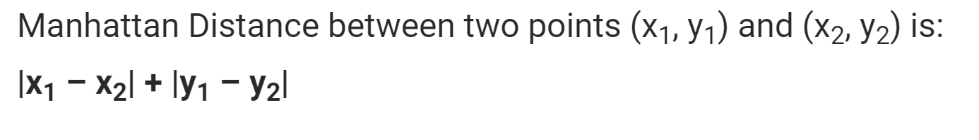
GEOMETRIC MODELS – DISTANCE BASED
The distance metrics commonly used are Euclidean
& Manhattan

Slide 32
PROBABILISTIC MODELS
Probabilistic models use the idea of probability to classify new entities.
Probabilistic models see features and target variables as random variables.
There are two types of probabilistic models:
Predictive and Generative
Predictive probability models use the idea of a conditional probability distribution P (Y |X) from which Y can be predicted from X.
Generative models estimate the joint distribution P (Y, X).
The joint distribution looks for a relationship between two variables.

Slide 33
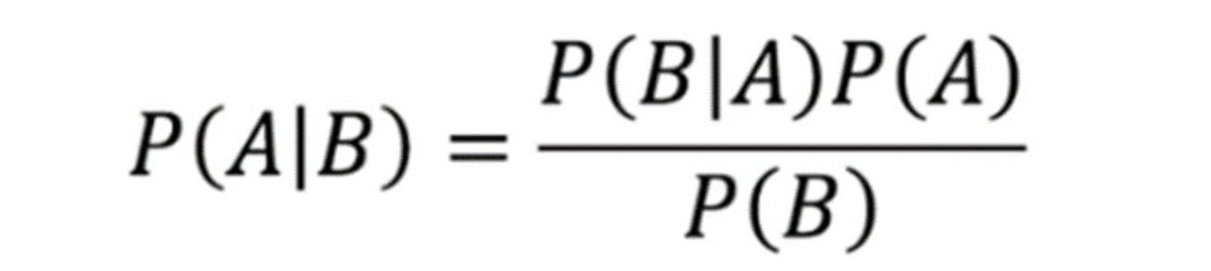
PROBABILISTIC MODELS
Naïve Bayes is an example of a probabilistic classifier.
The goal of any probabilistic classifier is given a set of features (x_0 through x_n) and a set of classes (c_0 through c_k), we aim to determine the probability of the features occurring in each class, and to return the most likely class. Therefore, for each class, we need to calculate P(c_i | x_0, …, x_n).
We can do this using the Bayes rule defined as

Slide 34
PROBABILISTIC MODELS
The Naïve Bayes algorithm is based on the idea of Conditional Probability. Conditional probability is based on finding the probability that something will happen, given that something else has already happened.

Slide 35
PREDICTIVE AND DESCRIPTIVE TASKS
Descriptive: This term is basically used to produce correlation, cross-tabulation, frequency etc. These technologies are used to determine the similarities in the data and to find existing patterns. This analytics emphasis on the summarization and transformation of the data into meaningful information for reporting and monitoring.
Predictive: The main goal of this is to say something about future results not of current behaviour. It uses the supervised learning functions which are used to predict the target value.

Slide 36
PREDICTIVE AND DESCRIPTIVE TASKS
Descriptive Learning : Using descriptive analysis you came up with the idea that, two products A (Burger) and B (French fries) are brought together with very high frequency. Now you want that if user buys A then machine should automatically give him a suggestion to buy B. So by seeing past data and deducing what could be the possible factors influencing this situation can be achieved using ML.
Predictive Learning : We want to increase our sales, using descriptive learning we came to know about what could be the possible factors influencing sales. By tuning the parameters in such a way so that sales should be maximized in the next quarter, and therefore predicting what sales we could generate and hence making investments accordingly. This task can be handled using ML also.

Slide 37
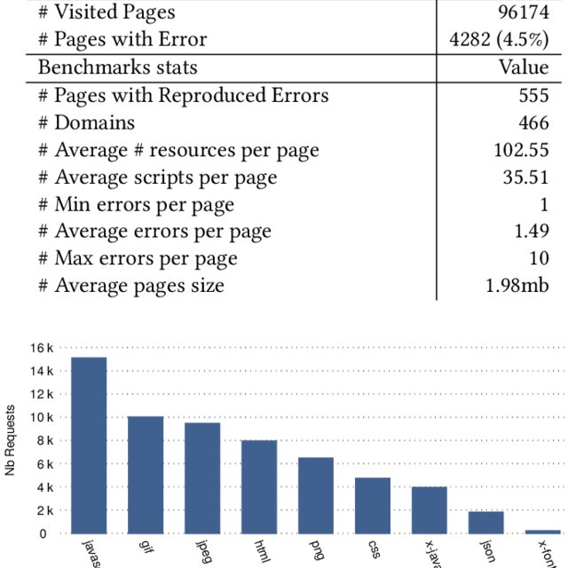
DESCRIPTIVE TASKS EXAMPLE

Slide 38

PREDICTIVE TASKS EXAMPLE

Slide 39
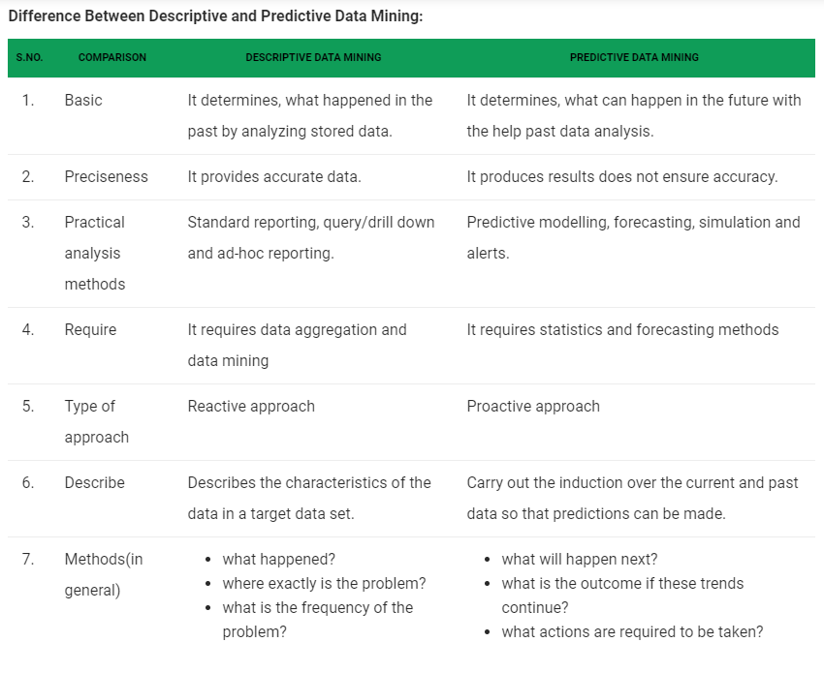

Slide 40

CHARACTERISTICS OF MACHINE LEARNING TASKS
The ability to perform automated data visualization. ...
Automation at its best. ...
Customer engagement like never before. ...
The ability to take efficiency to the next level when merged with IoT, RPA. ...
The ability to change the mortgage market. ...
Accurate data analysis.
Business intelligence at its best

Slide 41

FEATURES: FEATURE TYPES
There are three distinct types of features:
Quantitative, Ordinal & Categorical
We can also consider a fourth type of feature—the Boolean—as this type does have a few distinct qualities, although it is actually a type of categorical feature.
These feature types can be ordered in terms of how much information they convey. Quantitative features have the highest information capacity followed by ordinal, categorical, and Boolean.

Slide 42
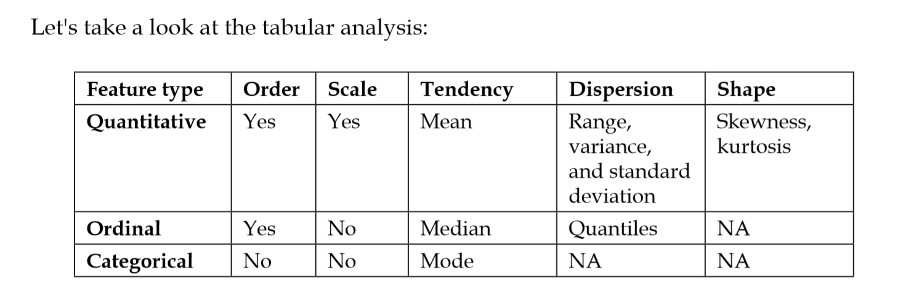
FEATURES: FEATURE TYPES

Slide 43
FEATURES: UNDERSTANDING FEATURE
What are Features? A feature is an input variable, that goes in the model as an input.
Feature construction is a process that discovers missing information about the relationships between features.
How to construct new features? Various approaches can be categorized into four groups data driven, hypothesis driven, knowledge based and hybrid.
The data driven approach is to construct new features based on analysis of the available data.
The hypothesis driven approach is to construct new features based on the hypotheses generated previously from the data.

Slide 44
WHAT IS A FEATURE?
A feature is an attribute of a data set that is used in a machine learning process.
There is a view amongst certain machine learning practitioners that only those attributes which are meaningful to a machine learning problem are to be called as features. (Pinch of Salt Practitioners)
In fact, selection of the subset of features which are meaningful for machine learning is a sub-area of feature engineering.
The features in a data set are also called its dimensions. So a data set having ‘n’ features is called an n-dimensional data set.

Slide 45
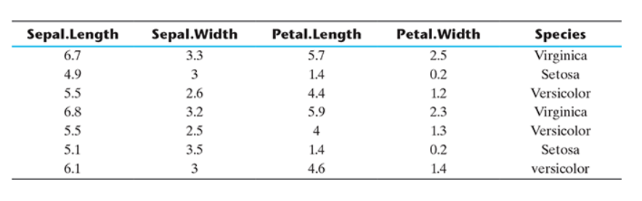
FEATURE EXAMPLE
Let’s take the example of a famous machine learning data set, Iris, introduced by the British statistician and biologist Ronald Fisher,
It has five attributes or features namely Sepal Length, Sepal Width, Petal Length, Petal Width and Species.
Out of these, the feature ‘Species’ represent the class variable and the remaining features are the predictor variables. It is a five-dimensional data set.

Slide 46
WHAT IS FEATURE ENGINEERING?
Feature engineering refers to the process of translating a data set into features such that these features are able to represent the data set more effectively and result in a better learning performance.
Feature engineering is an important pre-processing step for machine learning. It has two major elements:
1. Feature transformation
2. Feature selection

Slide 47
FEATURE TRANSFORMATION
Feature transformation transforms the data – structured or unstructured, into a new set of features which can represent the underlying problem which machine learning is trying to solve.
There are two variants of feature transformation:
Feature construction
Feature extraction
Both are sometimes known as feature discovery.

Slide 48
FEATURE CONSTRUCTION & EXTRACTION
Feature construction process discovers missing information about the relationships between features and the feature space by creating additional features. Hence, if there are ‘n’ features or dimensions in a data set, after feature construction ‘m’ more features or dimensions may get added. So at the end, the data set will become ‘n + m’ dimensional.
Feature extraction is the process of extracting or creating a new set of features from the original set of features using some functional mapping.

Slide 49
FEATURE TRANSFORMATION
In case a model has to be trained to classify a document as spam or non-spam, we can represent a document as a bag of words.
Then the feature space will contain all unique words occurring across all documents.
This will easily be a feature space of a few hundred thousand features.
If we start including bigrams or trigrams along with words, the count of features will run in millions.
To deal with this problem, feature transformation comes into play.
Feature transformation is used as an effective tool for dimensionality reduction and hence for boosting learning model performance.
There are two distinct goals of feature transformation:
Achieving best reconstruction of the original features in the data set
Achieving highest efficiency in the learning task

Slide 50
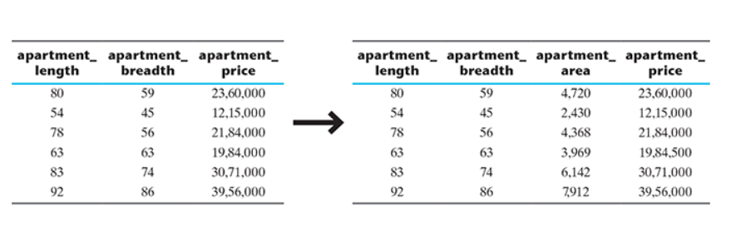
FEATURE CONSTRUCTION
Feature construction involves transforming a given set of input features to generate a new set of more powerful features.
To understand more clearly, let’s take the example of a real estate data set having details of all apartments sold in a specific region.
The data set has three features – apartment length, apartment breadth, and price of the apartment.
If it is used as an input to a regression problem, such data can be training data for the regression model.
So given the training data, the model should be able to predict the price of an apartment whose price is not known or which has just come up for sale.
However, instead of using length and breadth of the apartment as a predictor, it is much convenient and makes more sense to use the area of the apartment, which is not an existing feature of the data set.
So we transform the three-dimensional data set to a four-dimensional data set, with the newly ‘discovered’ feature apartment area being added to the original data set.

Slide 51
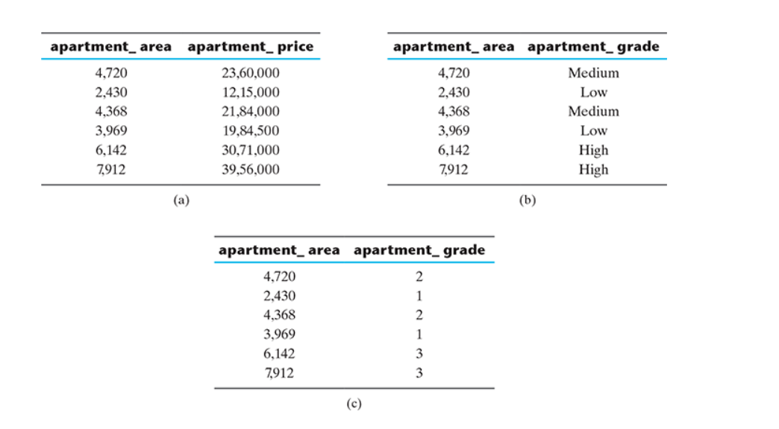
FEATURE CONSTRUCTION EXAMPLE

Slide 52
FEATURE SELECTION
Feature selection is the ML process of finding the subset of features that are most relevant for a better predictive model.
When presented data with very high dimensionality(large no. of features), models usually choke because:
Less training time & Risk of overfitting.
Feature selection methods can help identify as well as remove redundant and irrelevant attributes from data that do not contribute to the predictive power of the model.

Slide 53
FEATURE SELECTION
The objective of feature selection is three-fold:
-Improving the prediction performance of the predictors.
-Providing faster and more cost-effective predictors.
-Providing a better understanding of the underlying process that generated the data.
Algorithms of Feature Selection:
Following are the categories, the different Feature Selection attributes are broadly divided into:
1. Filter Method
2. Wrapper Method
3. Embedded Method

Slide 54

FEATURE SELECTION- FILTER METHOD
Filter Method - Filter Method are used to find the relationship between features and the target variable. This results in computing the importance of features.

Slide 55
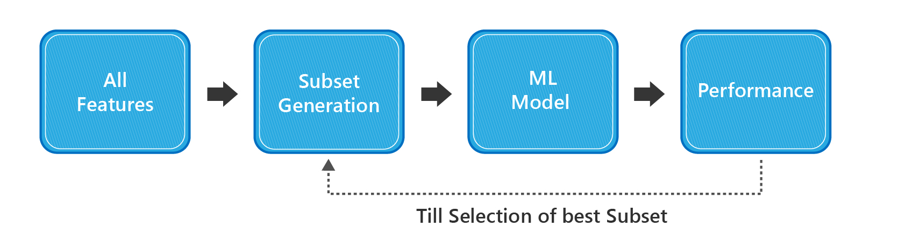
FEATURE SELECTION-WRAPPER METHOD
Wrapper Method –
Wrapper Methods selects best subset of features by iteratively checking model performance.

Slide 56
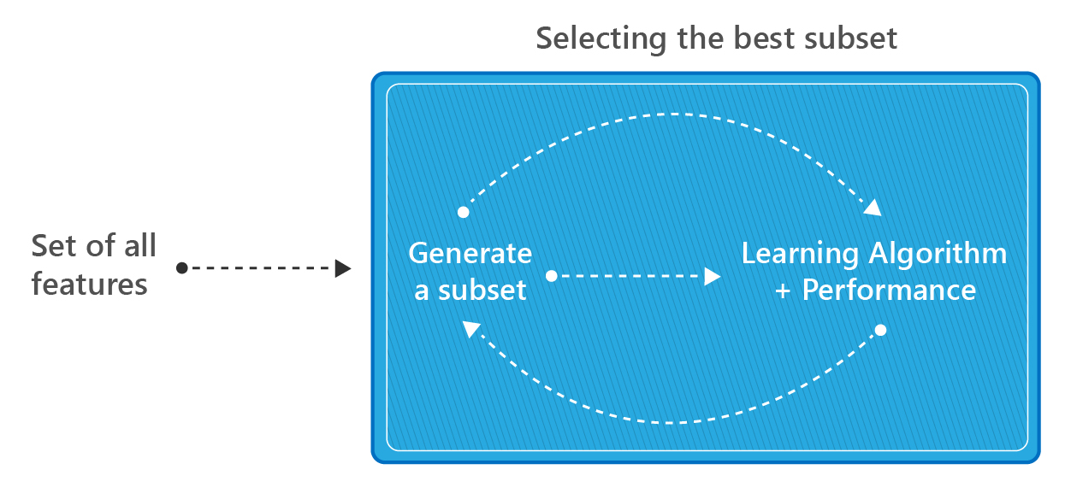
FEATURE SELECTION- EMBEDDED METHOD
Embedded Method –
Embedded methods are the methods implemented by algorithms that have a built-in feature selection 'embedded' in them. It selects the best subset of features during the building of the model itself.

Slide 57

KUDOS ..END OF UNIT 1

